Slide 1
Perceiver: General Perception with Iterative Attention
Andrew Jaegle Felix Gimeno Andrew Brock Andrew Zisserman Oriol Vinyals Joao Carreira
ICML 2021, Google DeepMind

Slide 2
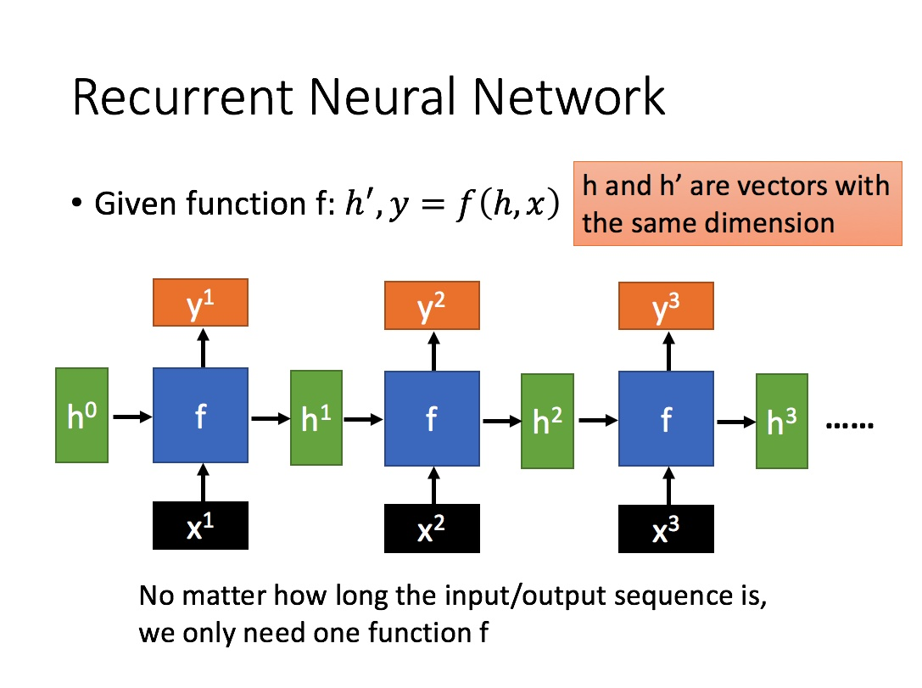
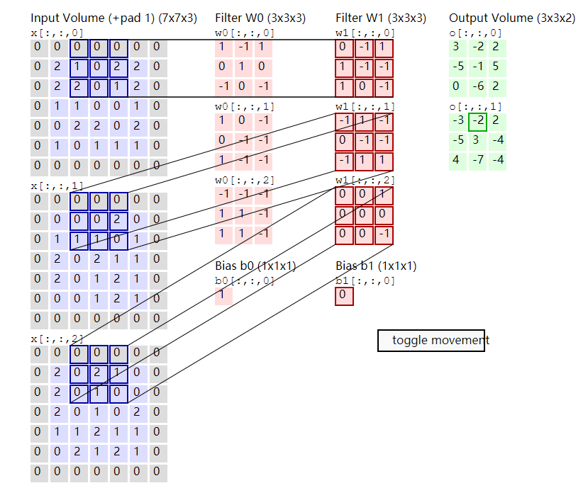
Motivation
Should we bake modality priors into models with hard architectural design?
Or are we better off building in as much as flexibility as possible and encouraging the data to speak for itself? --LeCun
Strong architectural priors are often modality-specific.
We are forced to redesign the architecture we use every time the input changes.
This paper introduces perceiver: a model designed to handle arbitrary configurations of different modalities using a single Transformer-based architecture.
Convolution for 2D grid input
RNN for 1D sequence input
Notes:
Given a pixel in an image, it is in some kind of relation to the pixels around it.
So it is naturally to build model using this prior knowledge.
Convolutional neural network using a sliding filter to slide over the image with all shared weights.
This design says that what matters to a pixel is the pixels around it.

Slide 3
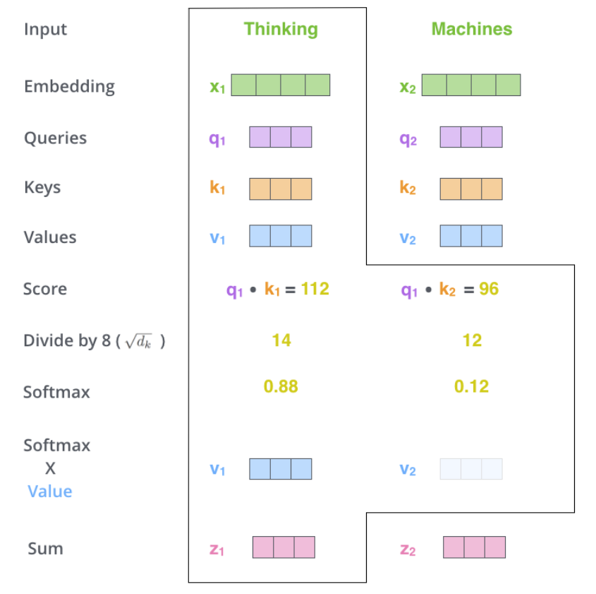
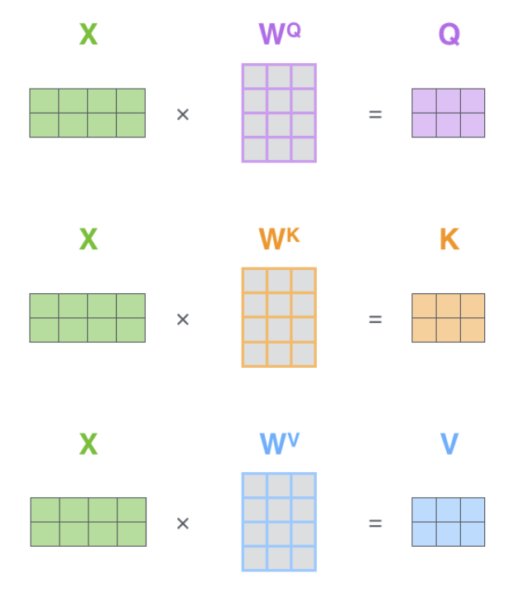
Quadratic Bottleneck in Self-Attention
Output
Attention
Input
$attention weight= softmax\left(QK^{T}\right)V Q,K∈R^{M∗D} V∈R^{M∗C}$
The complexity is $M∗M∗D+M∗M∗C=O(M^{2})$, assuming the input sequence is very long (224*224 for a image).

Slide 4
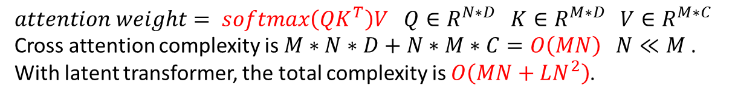
Cross Attention
Input
Array
K
V
Cross Attention
Latent Transformer
Latent
Array
Q
$attention weight= softmax\left(QK^{T}\right)V Q∈R^{N∗D} K∈R^{M∗D} V∈R^{M∗C}$
Cross attention complexity is $M∗N∗D+N∗M∗C=O\left(MN\right) N≪M$.
With latent transformer, the total complexity is $O\left(MN+LN^{2}\right)$.

Slide 5
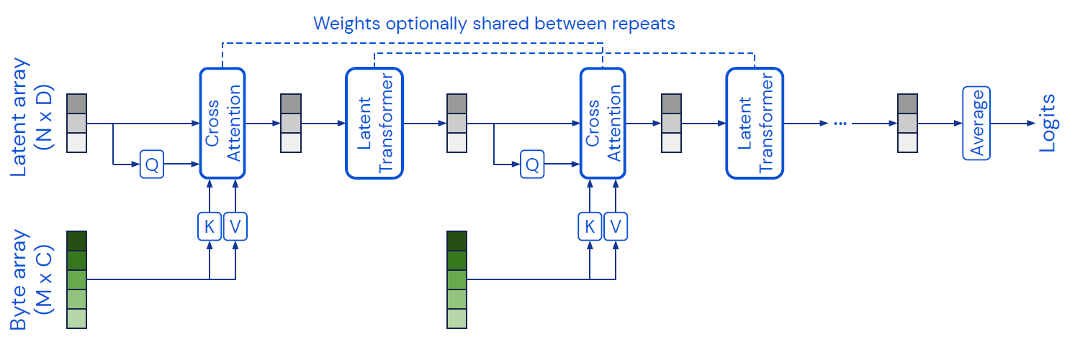
Iterative Cross Attention and Weight Sharing
Only one layer cross attention may not be capable to capture all of the necessary details.
Iterative cross attention allows us to make a balance between informative cross-attends and redundant latent self-attends.
To increase parameter efficiency, we share weights between the corresponding blocks.
Notes:
How to understand this?
The query is the questions you want to ask.
The key and value contains thousands of different kind information.
Cross attention is like to gather inputs as the answers.
The next query sees the data before, so it may look for more detailed information for a more accurate answer.

Slide 6
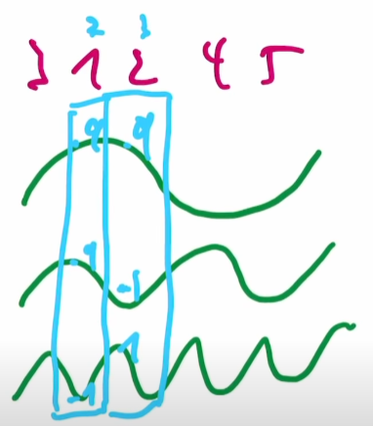
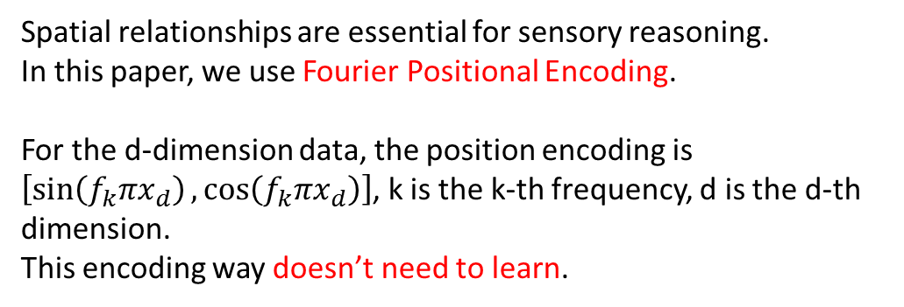
Positional Encoding
Spatial relationships are essential for sensory reasoning.
In this paper, we use Fourier Positional Encoding.
For the d-dimension data, the position encoding is
$\left[\sin\left(f_{k}πx_{d}\right),\cos\left(f_{k}πx_{d}\right)\right]$, k is the k-th frequency, d is the d-th dimension.
This encoding way doesn’t need to learn.

Slide 7
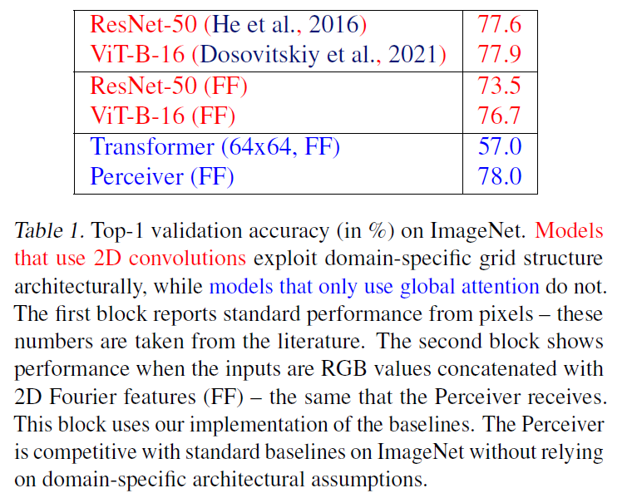
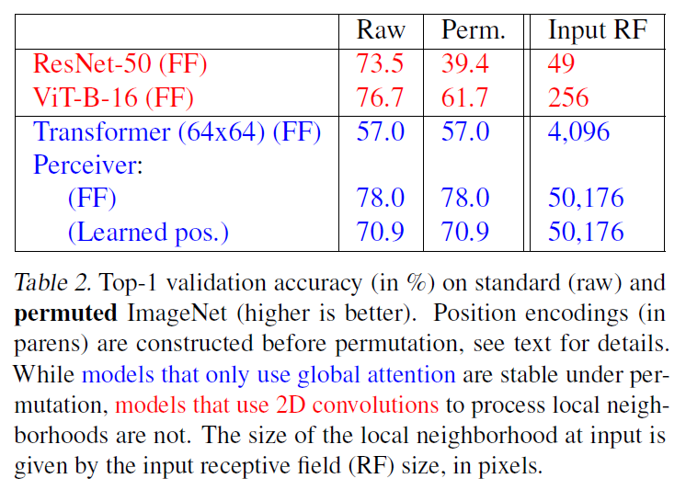
Results

Slide 8
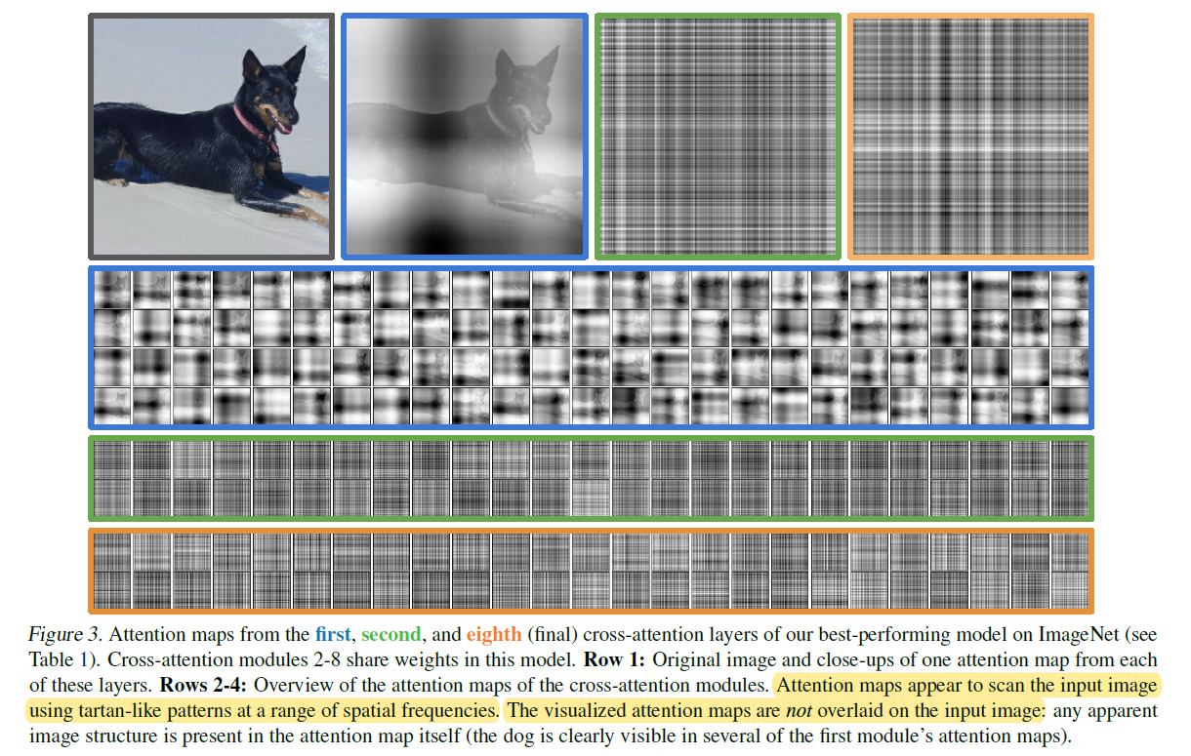
Attention Map Visualization

Slide 9
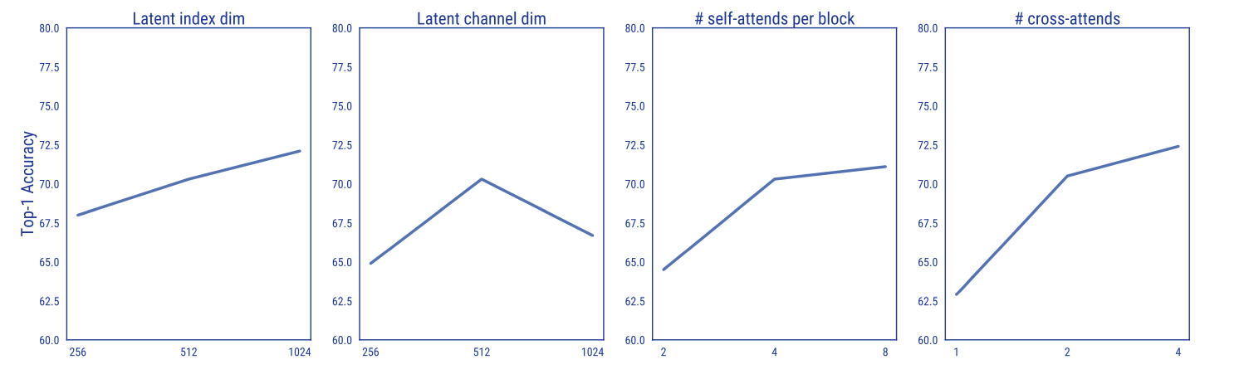
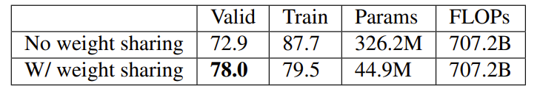
Ablation Study

